Slide 1

Quantum-Enhanced Single-Molecule Localization Microscopy Using SPAD Arrays A Computational Pipeline for Super-Resolution Imaging at High Emitter Densities
Rens van Dam

Slide 2
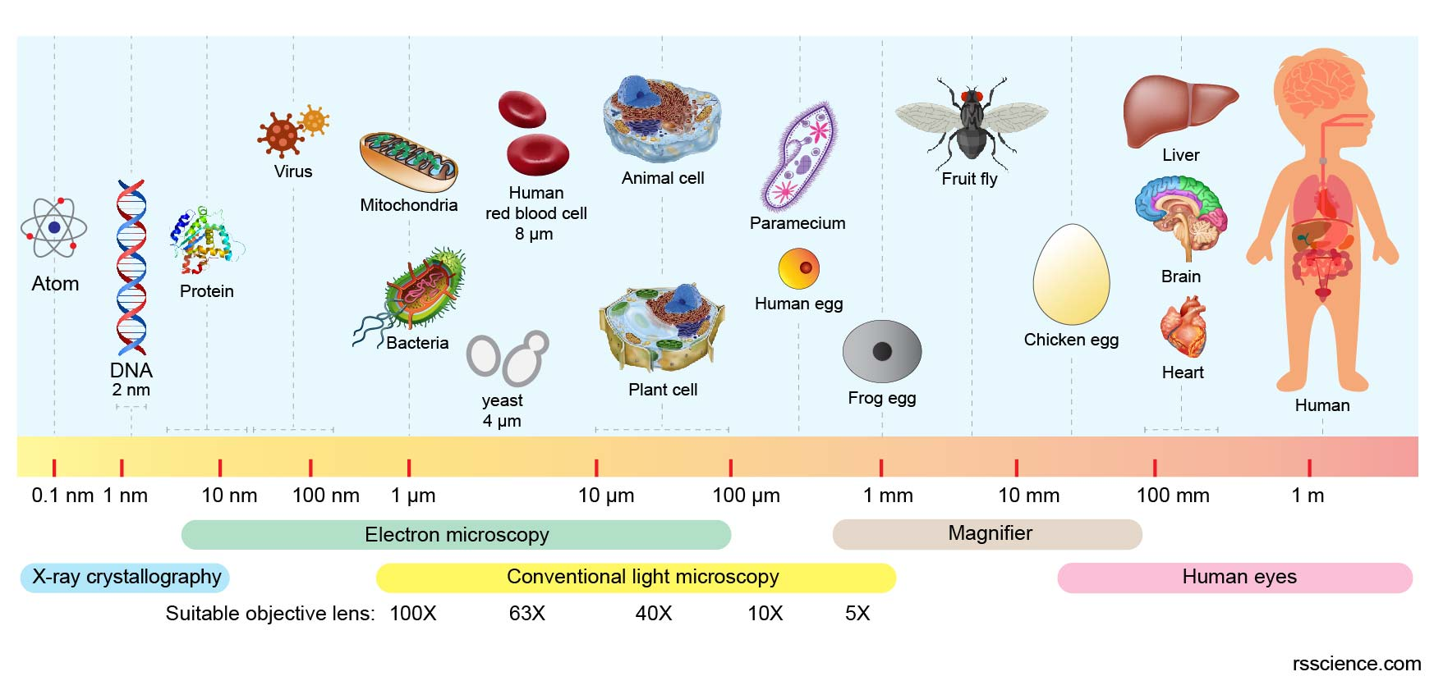

A limit to what we can see
$$d=λ/2NA$$
Notes:
The smallest detail you can see is approximately equal to the wavelength of light divided by 2x the numerical aperature, the lens openeing so to say. This was found already by Ernst Abbe in 1873.
Best way to think about it: if water hits the beach in Zeeland, large waves cannot ‘see’ the wooden posts,
This figure is correct, but we can’t use elctron microscopes on cells that easily: we want to use visible light to not destroy the tissue.
So: we are limited by lambda/2NA = 200 nm resolution for visible light. But what if we could go beyond?

Slide 3
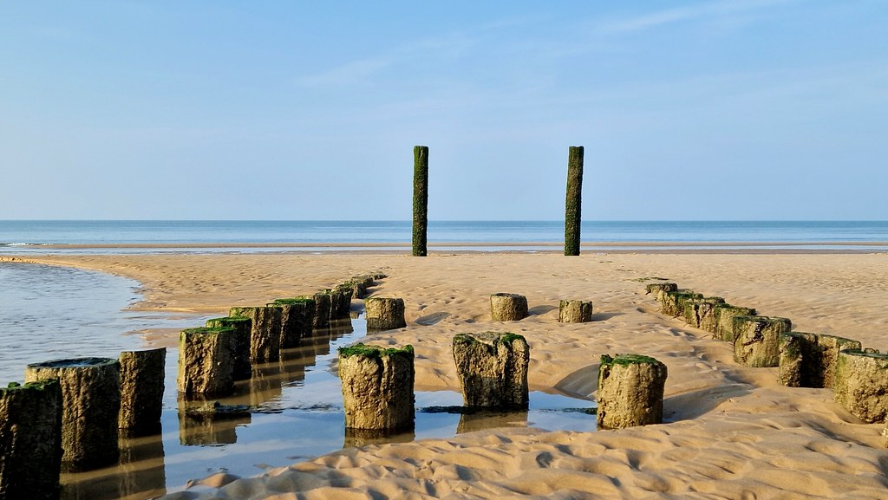
A limit to what we can see
Zoutelande (Lena Schreijenberg)
Notes:
The idea in macroscale: the waves of the sea in Zeeland are too large to resolve two posts close together; just like in a microscope, there is a limit to what you can see in detail for some wavelength.

Slide 4
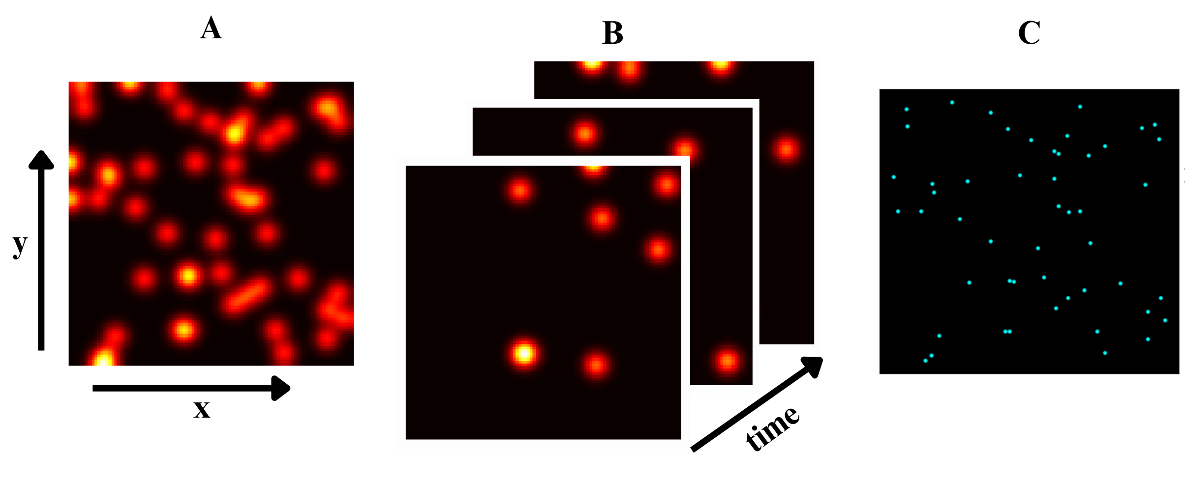
Single Molecule Localization Microscopy (SMLM)
Use fluorescent dyes with a blinking property to localize emitters in sparse frames
Able to reach ??? resolution improvement
Notes:
There are ways to go beyond the fundamental limit of 200 nm. One of them: SMLM
If the night sky would be filled with stars you would not be able to count them; yet if you could take pictures where only a few are on at each moment, you can count them in the seperate images and find their positions more closely.

Slide 9
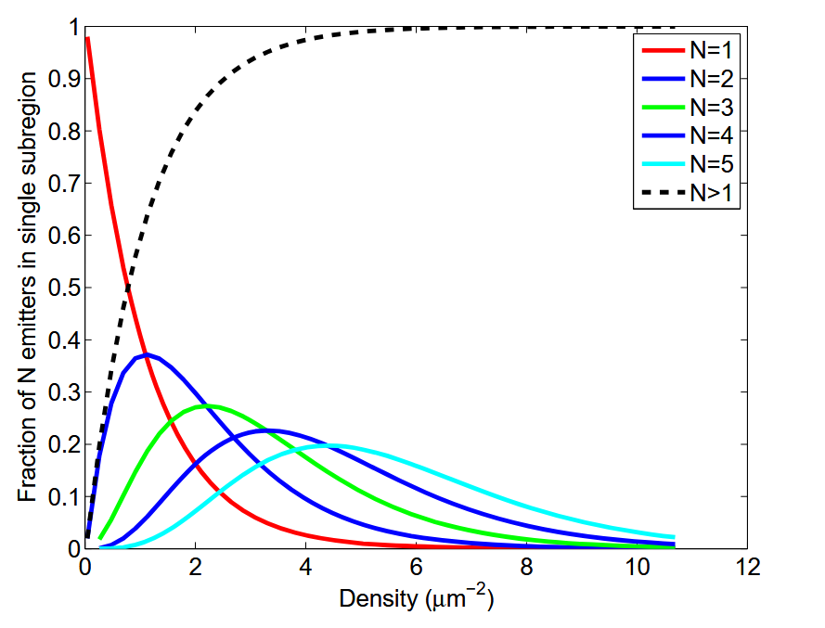

Single-Molecule Localization Microscopy
Restriction on emitter density:
1 emitter per diffraction-limited area
${10}^{−1}−1 emitters/μm^{2}$
Huang et al., 2011
Notes:
For normal SMLM algorithms, there is an upper bound on how dense the image can be in terms of emitters. This limit usually is about 1 emitter per diffraction limited area, and in practice 0.1 to 1 emitter per square micrometer is the density that normal algorithms perform well at.
However, in many cases we have higher density areas. Here, normal algorithms fail to localize the emitters properly, as it all becomes one ‘blob’.
This chart shows the fraction of N=1,2,3,4,5 emitters in a single subregion. For higher density locations, the number of subregions containing 2,3,4,5 emitters increases rapidly. Thus, there is a need for being able to simulate in this area.
[within a 8σPSF×8σPSF square sub-region (σPSF = 127 nm)]

Slide 10
Research goal
Simulate a SPAD scanning measurement and localize the emitters for high emitter density regions.
High emitter density region $≔$ $>1/μm^{2}$
Notes:
We define a high emitter density region as a region with >1 emitters/ micrometer squared.
We will now get two very busy slides that summarize my code. Get ready

Slide 11
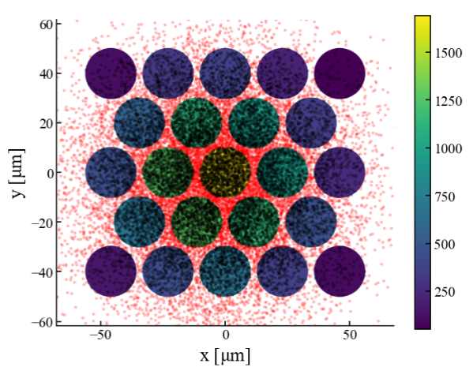
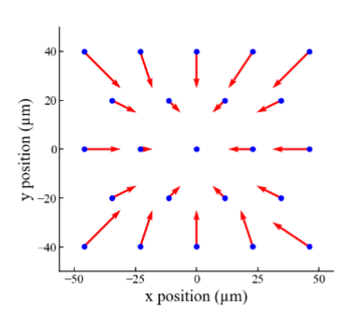
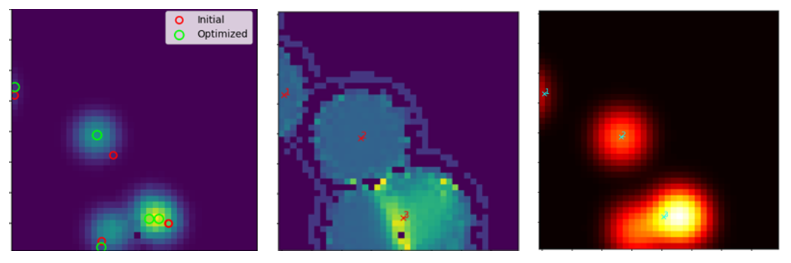
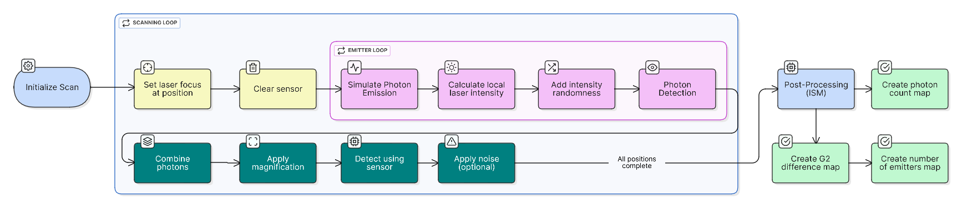
Simulated Measurement Pipeline
Notes:
In this slide, emphesize the relevant stages:
A) Scanning loop (for every scan position, i create a measurement on the SPAD sensor.
B) Emitter loop (for every emitter, I simulate a photon stream according to the excitation and emission rate that is specified. These are combined and detected.
C) Generating the final results

Slide 12
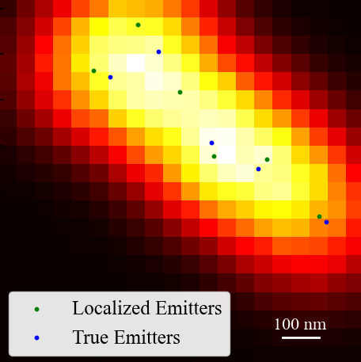
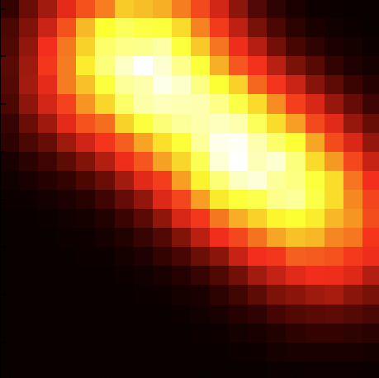
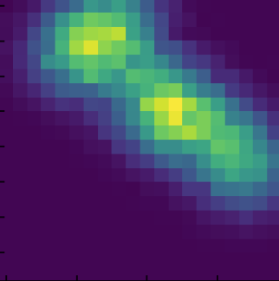
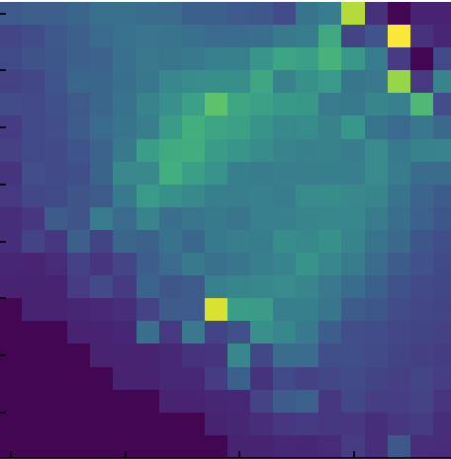
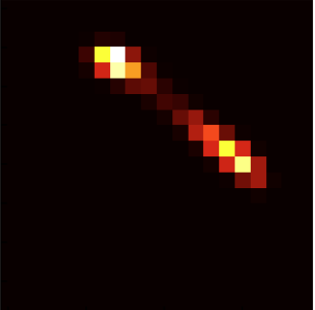
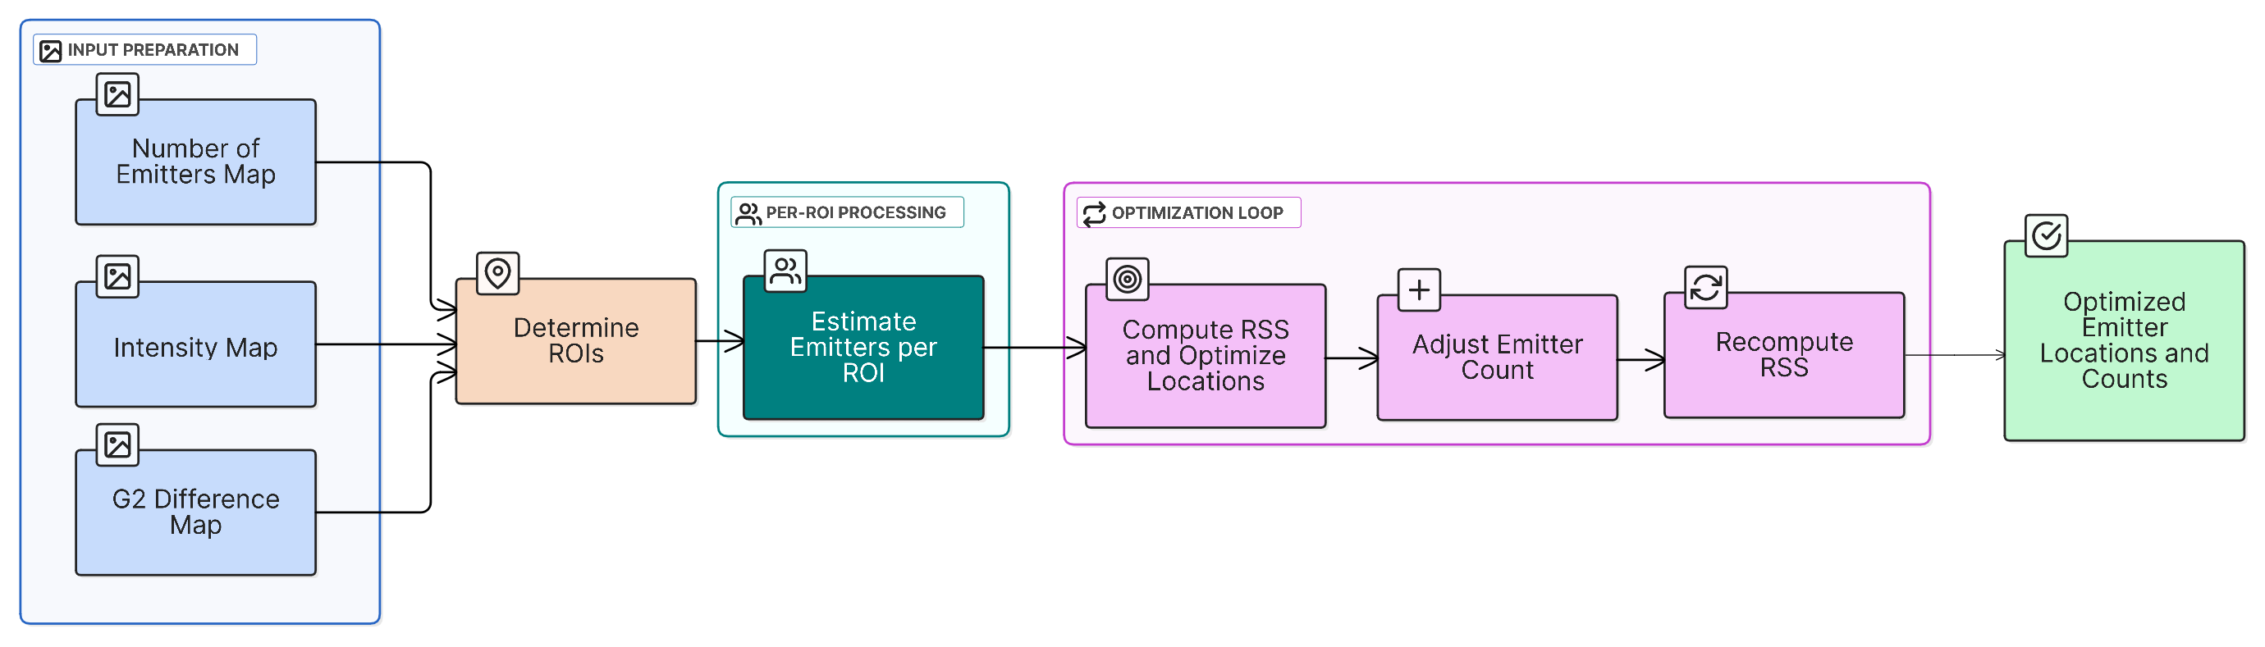
Localization Pipeline
Notes:
The parts of localization:
ROI finding: i use a richardson-lucy algorithm and the known PSF to deconvolve the g2 image. This way, I generate an image with even less overlap and more distinct ROI’s.
Emitter estimation for every ROI: For each of these ROI’s that I then have, i estimate the emitters: I overlap the number_of_emitters_map with the roi’s and for every roi, take the max value for the n_emitters on that ROI. That is my initial emitter number for that roi.
Optimization/localization loop including regularization on emitter count. I use the inital #emitters and calculate the RSS (50% G2, 50% intensity) with a regularization (punishment) term for the emitter count. What is the coefficient for the regularization term? Good question. This is still a limitation: it is something manually installed. After such a localizaition (minimization of RSS), I add ánd substract 1 emitter and do it again for both and then compare RSS. If an improvement is found, i adopt this new emitter count and do this again; else, i stop.

Slide 13
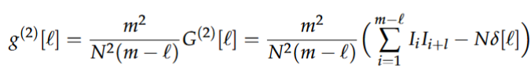

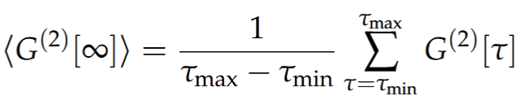
Photon Statistics & Estimating Emitters

Slide 14
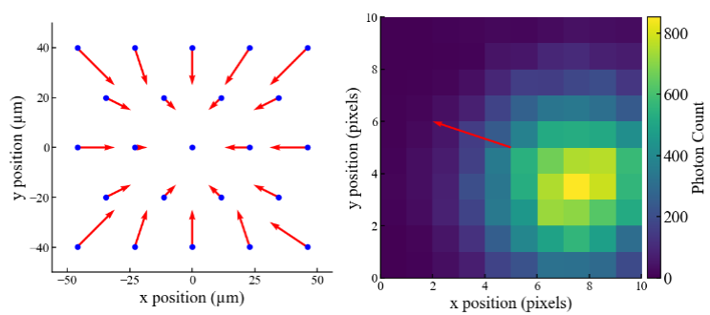

ISM Application
$σ_{laser}=162$ nm
Notes:
Show successful ISM implementation
Sigma = lambda/4NA, lambda emission wavelength
1.33x improvement by ISM, 1.44x theoretical

Slide 15
Results

Slide 16
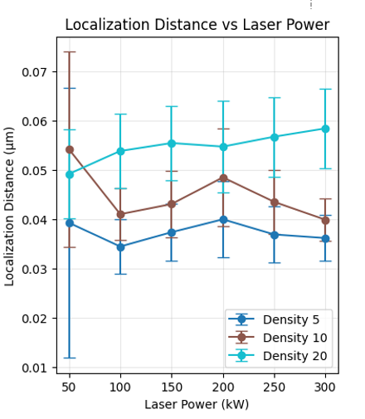
Results: no noise

Slide 17
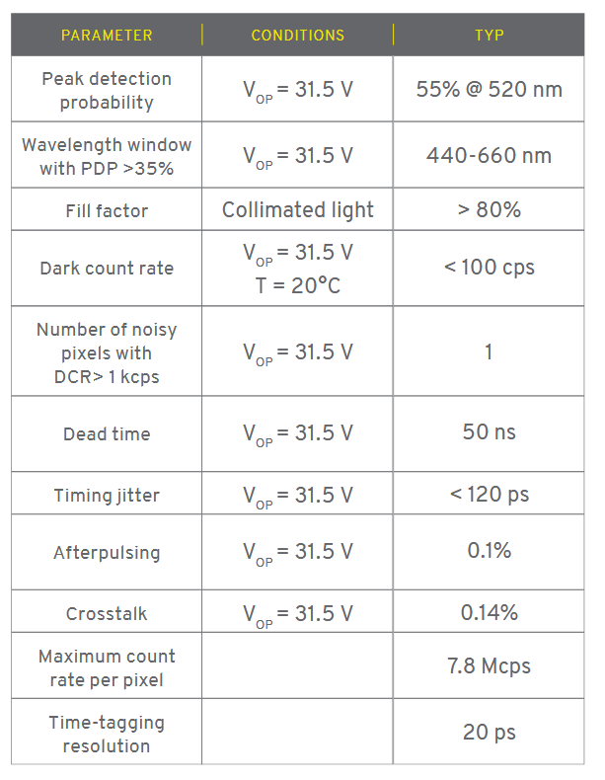
SPAD-Specific Considerations
Afterpulsing: 0.1%
Crosstalk: 0.14% chance for neighbouring pixel
Dark counts: 100 cps = 0.01 counts per 0.1 ms
Dead time: 50 ns
Dead time reduces max measured photons drastically, requiring a longer dwelll time or more intensity.
Notes:
Show results of noise types present in a spad: what is the limiting factor? What noise is less important?

Slide 18
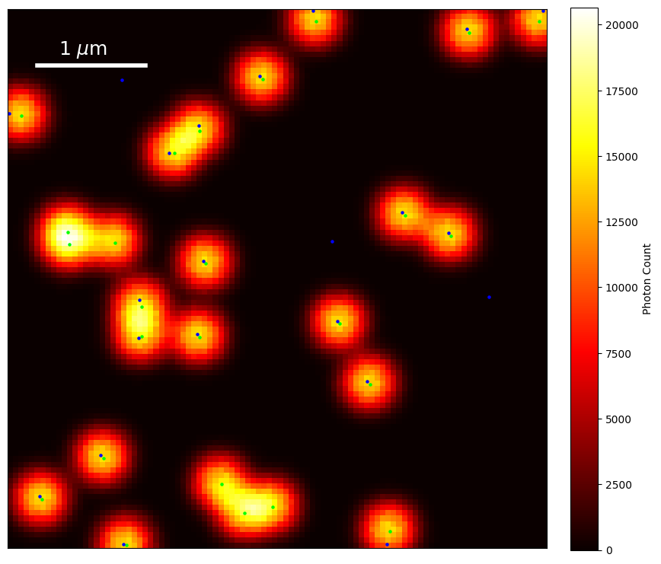
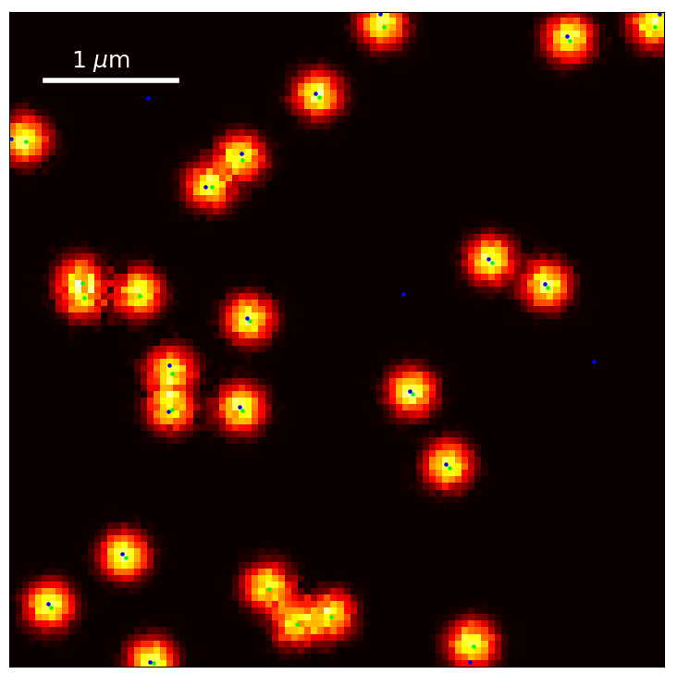
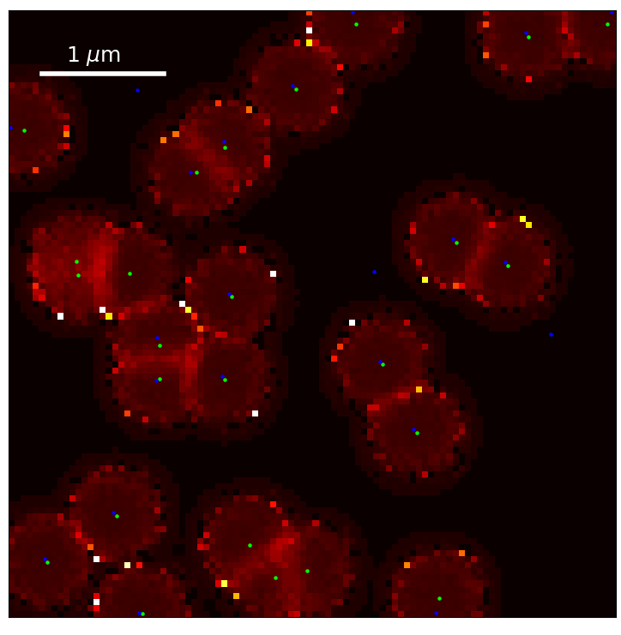
Large FOV
5x5, 100x100 scanning positions. 0.1 ms dwell time. Noise included
Emitter density 1
63 +/- 10 nm localization ; 0.96 detection rate

Slide 19
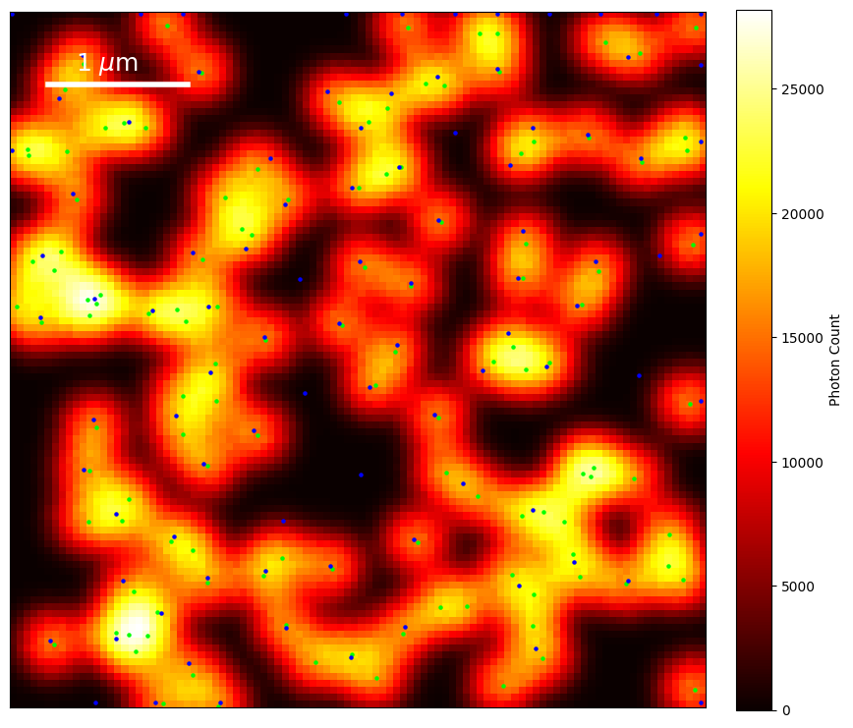
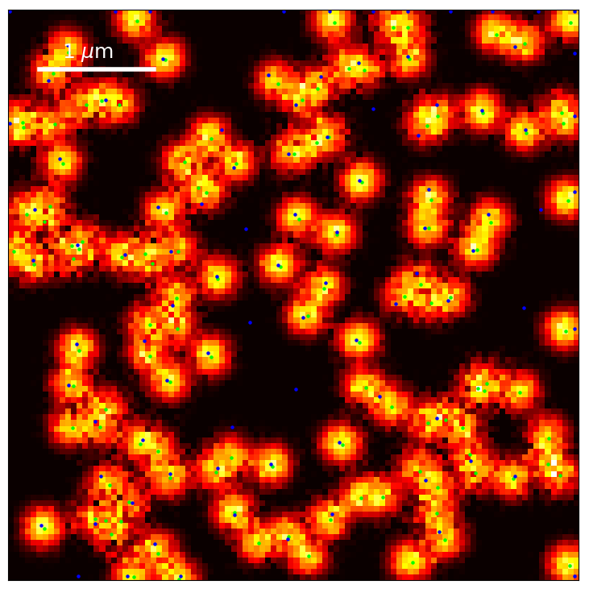
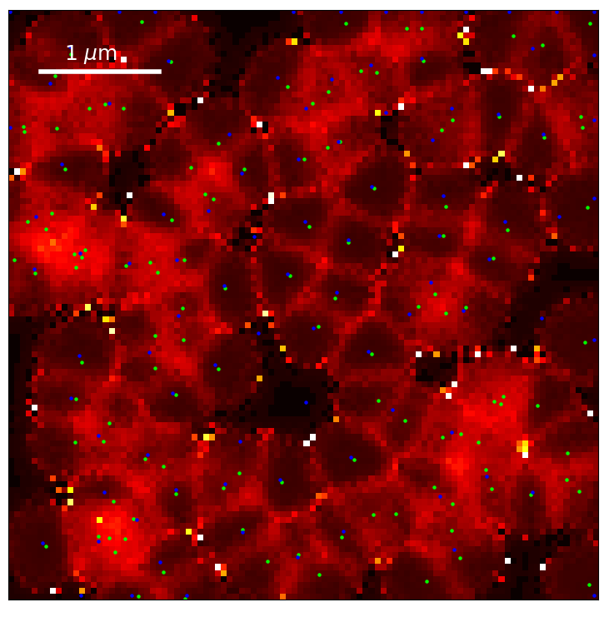
Large FOV
5x5, 100x100 scanning positions. 0.1 ms dwell time. Noise included
Emitter density: 5
95 +/- 11 nm localization; 0.73 detection rate
Notes:
1 emitter / um2 : 63 +/- 10 nm localization ; 0.96 detection rate
5 emitters / um2: 95 +/- 11 nm localization; 0.73 detection rate
FOR 0.5 ms dwell time:
1 emitter / um2: 64 ± 10 nm localization, 0.96 detection rate.
5 emitters / um2: 74 ± 4 nm localization, 0.998 detection rate

Slide 20
Large FOV localization quality
1 emitter / µm2
Localization: 63 ± 10 nm
Detection rate: 0.96
5 emitters / µm2:
Localization: 95 ± 11 nm
Detection rate: 0.73

Slide 21
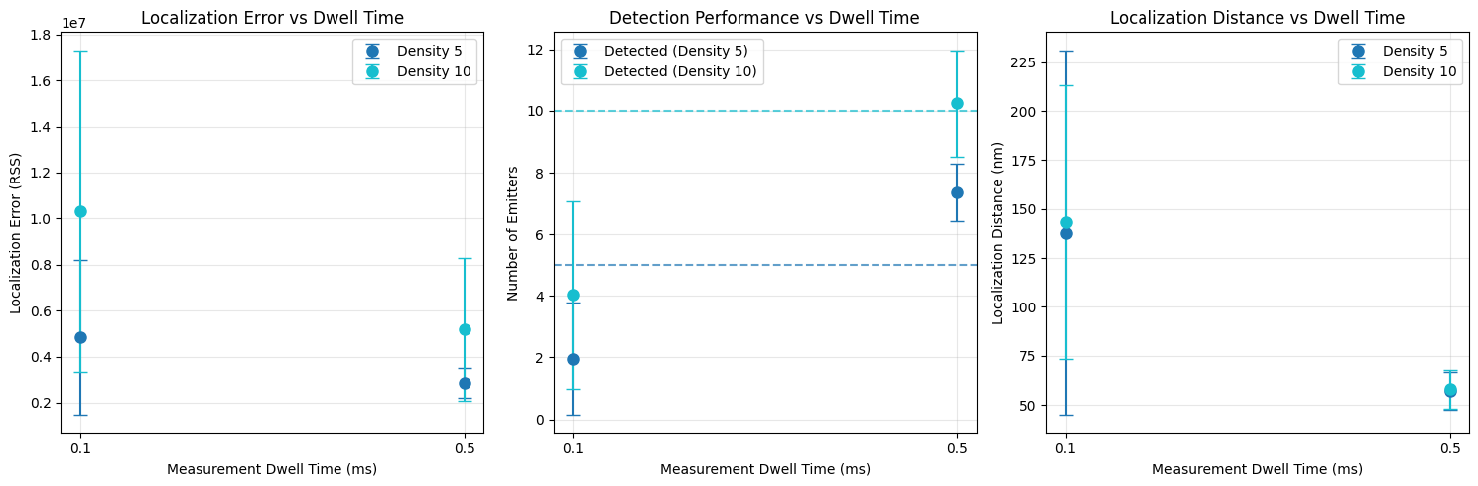

Slide 22

Outlook
Q-ISM implementation. Challenge: too low intensity => too few photons to calculate SPAD23 pixel-specific G2 values
Improving localization algorithm with ML approach instead of RSS
Notes:
Regarding Q-ISM: in the 2019 paper by Tenne they use 200 ms dwell times. So: 200x intensity

Slide 23
Questions

